Slide 1

Problem -3
Unilever Data Science POC Use Case -Deep Tech
Team – Data_wranglers
By: Shriti Datta

Slide 2
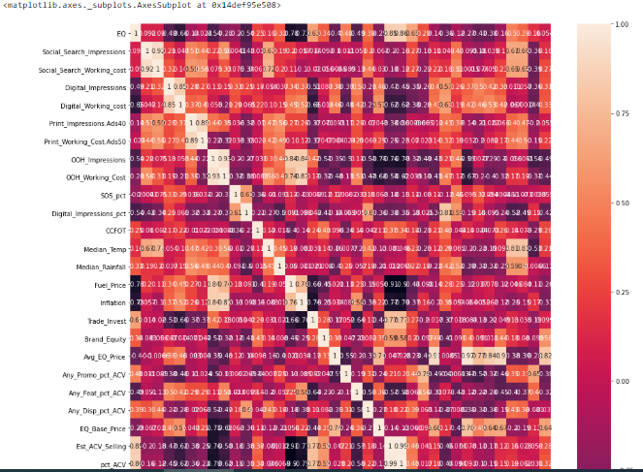
Sales Levers

Slide 3
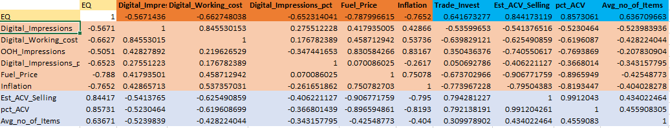
Feature Strength - Co-relation Coefficient with ‘EQ’, >0.6 or <-0.6

Slide 4
Linear Regression Model

Slide 5
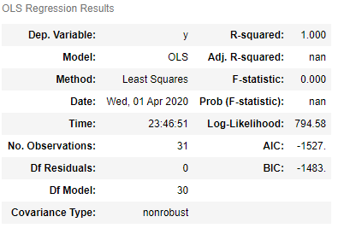
Linear Regression Model Summary

Slide 6
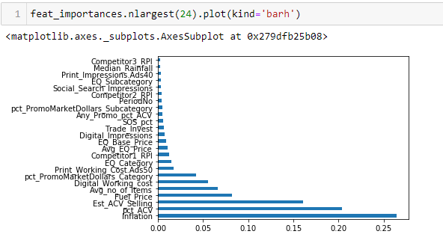
Random Forest - Feature Importance

Slide 7
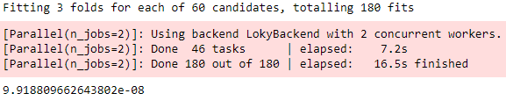

Model - GridSearchCV
RMSE

Slide 8
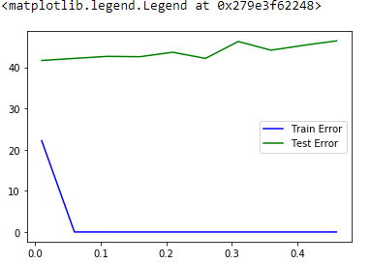
GradientBoostingRegressor
GradientBoostingRegressor(n_estimators=175, learning_rate=learning_rate, random_state=0,max_depth=4)

Slide 9
Conclusion
Available data is very less.
The created prediction models are overfitting.
We need to regularize the data to reduce this overfitting.

